Slide 1
Hypertrophic cardiomyopathy
Sreejith V
Senior Resident
Cardiology

Slide 2
Outline
Definition
Genetics
Pathophysiology
Clinical features
Evaluation
Treatment

Slide 3
DEFINITION
HCM is a genetic disease state characterized by unexplained LV hypertrophy associated with nondilated ventricular chambers in the absence of another cardiac or systemic disease that itself would be capable of producing the magnitude of hypertrophy evident in given patient.
It’s prevalance estimated to be 1:500
IHSS, HOCM, and MSS are older terms

Slide 4
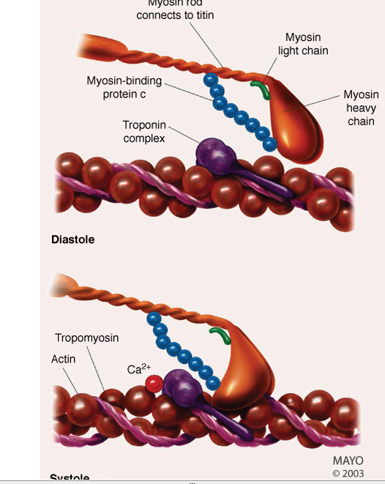
Notes:
Genes mcc – mhc/mypc

Slide 5
Beta MHC mutations-clinical presentation apparent by late adolescents and develop substantial hypertrophy and more severe diseases.
MyBPC mutations can have delayed clinical presentation until age 50 or older.Less severe symptoms.
cTnT mutations-modest hypertrophy, increased risk of sudden death
cTnI mutations- Greater predisposition of apical hypertrophy
Alpha tropomyosin-relatively good survival. Variable degree of hypertrophy

Slide 6
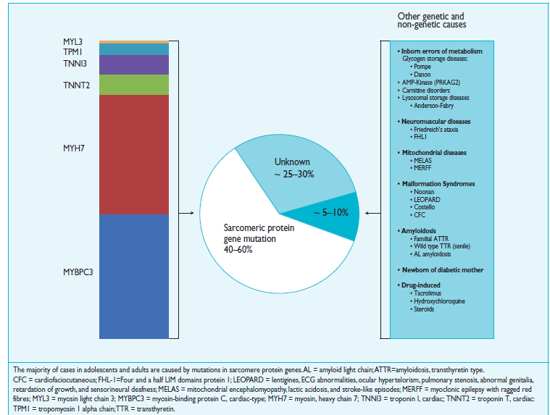

Slide 7
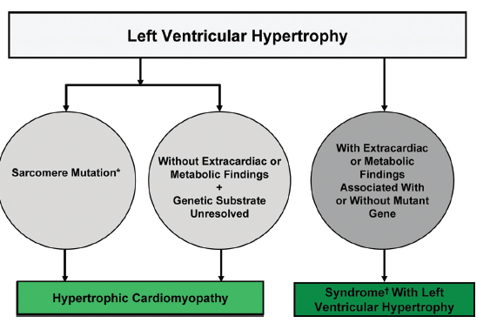

Slide 8
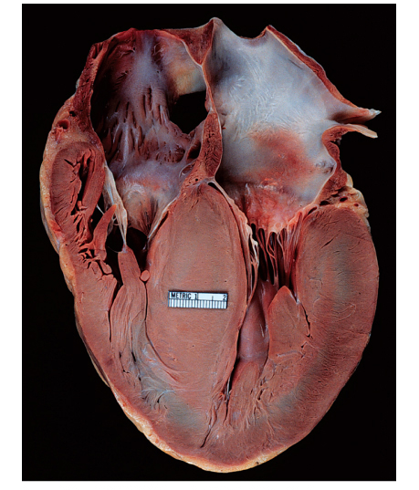
HISTOPATHOLOGY
Whorling and fibrosis

Slide 9
PATHOPHYSIOLOGY
LV outflow tract obstruction
Diastolic dysfunction
Myocardial ischemia
Mitral regurgitation
Arrhythmias
End stage/ burned out

Slide 10
LV OUTFLOW OBSTRUCTION
Produced by SAM of mitral valve
Explanations for the SAM of the mitral valve
Mitral valve is drawn toward the septum because of the lower pressure that occurs as blood is ejected at high velocity through a narrowed outflow tract (Venturi effect)
Mitral valve is pulled against the septum by contraction of the papillary muscles, which occurs because of the valve's abnormal location and septal hypertrophy altering the orientation of the papillary muscles
Hydrodynamic “drag” or the “pushing” force of flow

Slide 11
DYNAMIC OBSTRUCTION IS WORSENED BY
Increase in contractility
VPC
Dobutamine,Isoproterenol
Exercise
Decrease in afterload/volume
Valsalva maneuver
Standing
Nitroglycerine/amylnitrite inhalation
Blood loss
Dehydration

Slide 12
DEFINITIONS OF DYNAMIC LEFT VENTRICULAR OUTFLOW TRACT OBSTRUCTION
Hemodynamic state | Conditions | Outflow gradient
Basal obstruction | Rest | >30mmHg
Non obstructive | Rest | <30mmHg
 | Physiologically provoked | <30mmHg
Dynamic obstruction | Rest | <30mmHg
 | Physiologically provoked | >30mmHg

Slide 13
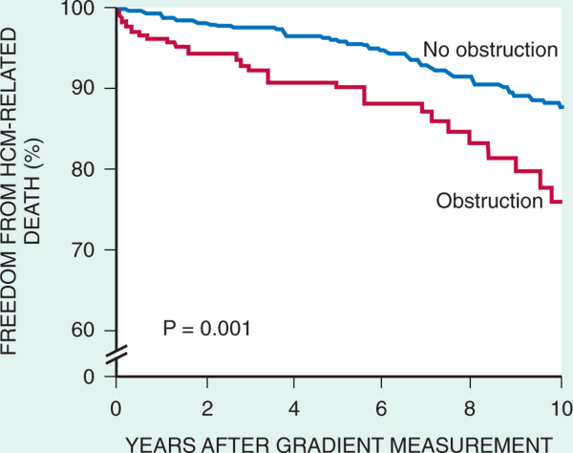
FREEDOM FROM HCM RELATED DEATHS
Maron MS et al. NEJM. 2003;348:295.

Slide 14
DYNAMIC LVOT OBSTRUCTION - DDS
Hypercontractile states
Anomalous papillary muscle insertion
Anteroapical infarction with hyperkinetic basal segments
Elderly women with LVH/sigmoid septum and hyperdynamic ventricular function
After mitral valve repair

Slide 15
DIASTOLIC DYSFUNCTION
Impaired relaxation
Decreased compliance
Hypertrophy
Disorganised cellular architecture
Replacement scarring
Interstitial fibrosis
Accounts for symptoms of exertional dyspnea
Increased filling pressures → increased pulmonary venous pressure

Slide 16
MYOCARDIAL ISCHEMIA
Often occurs without atherosclerotic coronary artery disease
Postulated mechanisms
Abnormally small and partially obliterated intramural coronary arteries as a result of hypertrophy
Inadequate number of capillaries for the degree of LV mass and increased myocardial oxygen consumption-supply demand mismatch
Increased filling pressures resulting in subendocardial ischemia

Slide 17
MITRAL VALVE APPARATUS
Twice the normal size due to elongation of both leaflets or segmental enlargement of only anterior leaflet or mid portion of posteror leaflet
Congenital and anomalous anterolateral papillary muscle insertion into the anterior leaflet without interposition of chordae tendineae and produce muscular midcavity outflow obstruction >>SAM>>LVOTO
Variations in leaflet length (posterior/anterior leaflet length mismatch) – restrict the ability of the posterior leaflet to follow the anterior leaflet and to coapt effectively resulting in MR
Severity of MR directly proportional to LV outflow obstruction
Results in symptoms of dyspnea, orthopnea

Slide 18
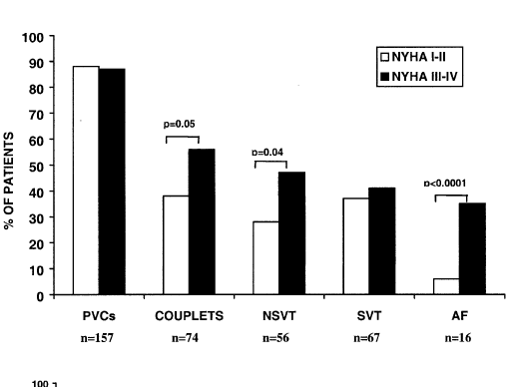
ARRHYTHMIAS
Adabag AS¹ J Am Coll Cardiol. 2005 Mar 1;45(5):697-704- total 178 patients.

Slide 19
CLINICAL PRESENTATION
Majority are asymptomatic
Dyspnea on exertion (90%), orthopnea, PND
Palpitations (PAC, PVC, sinus pauses, AF, A flutter, SVT and VT)
Congestive heart failure (2º to increased filling pressures and myocardial ischemia)
Sudden cardiac death (<1%)
Angina (70-80%)
Syncope (20%), Presyncope (50%)
Outflow obstruction worsens with increased contractility during exertional activities resulting in decrease in cardiac output
Secondary to arrhythmias

Slide 20
PHYSICAL
Jugular venous pulse: prominent a- wave
Double carotid arterial pulse: declines in mid systole as gradient develop
Double apical impulse:
Forceful left atrial contraction against non-compliant ventricle
Triple apical impulse:
Late systolic bulge near isometric contraction
S1: normal
S2: normal or paradoxical split
S3 gallop: decompensated Lt. ventricle
S4: atrial systole against hypertrophic ventricle

Slide 21
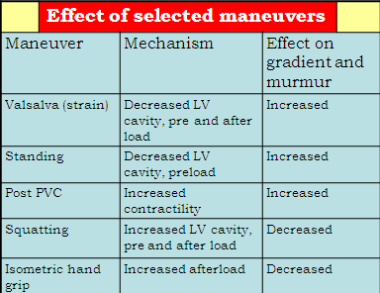
ESM-BETWEEN APEX AND LLSB

Slide 22
PHYSICAL
Holosystolic Murmur of MR:
Retrograde ejection of blood flow into low pressure left atrium
Best heard at apex and axilla
Pt. with SAM* and significant LV outflow gradients
Diastolic Decrescendo Murmur of AR: 10% of Pt.
* Systolic anterior motion

Slide 23
MIMICKING HYPERTROPHIC CARDIOMYOPATHY
Chronic hypertension
RV hypertrophy
Cardiac amyloidosis
Athlete's heart
Valvular AS
Apical hypertrophy - apical cavity obliteration caused by hypereosinophilic syndrome or noncompaction.

Slide 24
POINTS FAVOURING HCM IN HTN
Family history of HCM
Asymmetry
Right ventricular hypertrophy
Late gadolinium enhancement at the RV insertion points or localized to segments of maximum LV thickening on CMR
Maximum LV wall thickness ≥15 mm (Caucasian); ≥20 mm (black)
Severe diastolic dysfunction
Marked repolarisation abnormalities, conduction disease or Q-waves on 12 lead ECG
Regression of LVH
ESC Guidelines2014

Slide 25
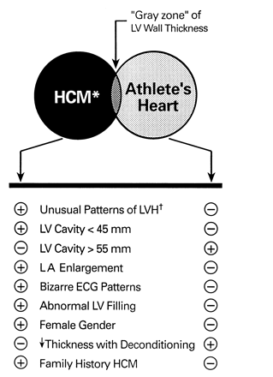
HCM VS. ATHLETE’S HEART
Circulation 1995;91.
Notes:
Long-term athletic training can produce “athlete’s heart” = increased LV diastolic cavity dimensions/wall thickness/mass.

Slide 26
HCM VS AORTIC STENOSIS
HCM Fixed Obstruction carotid pulse spike and dome parvus
murmur radiate to carotids ↑ valsalva, standing ↓ squatting, handgrip ↓ passive leg elevation
systolic thrill 4th left ics 2nd right ics systolic click absent present

Slide 27
DIAGNOSIS
ECG
IMAGING
- ECHOCARDIOGRAPHY
- CARDIAC MRI
- OTHER MODALITIES
CATH DATA
TESTS TO RISK STRATIFY PATIENTS
GENETIC TESTING
FAMILY SCREENING

Slide 28
ECG
Abnormal - >90% of pts & >75% of asymptomatic relatives
Increased voltages consistent with LV hypertrophy
ST-T changes - marked T wave inversion in the lateral precordial leads
Left atrial enlargement
Deep and narrow Q waves lateral precardial leads
Diminished R waves in the lateral precordial leads.
Normal ECG - 5% of pts
Less severe phenotype and favorable course
Not predictive of future sudden death

Slide 29
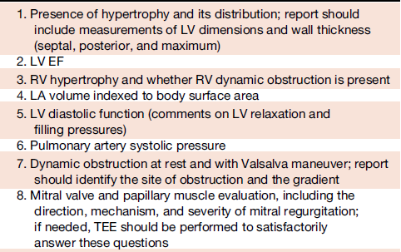
ECHOCARDIOGRAPHY A COMPREHENSIVE ECHO EVALUATION REPORT

Slide 33
LV hypertrophy
Diffuse hypertrophy of the ventricular septum and anterolateral free wall (70% to 75%)
Basal septal hypertrophy (10% to 15%)
Concentric hypertrophy (5%)
Apical hypertrophy (<5%)
Hypertrophy of the lateral wall (1% to 2%).

Slide 34
Notes:
Grading 10.. 30 % time

Slide 35
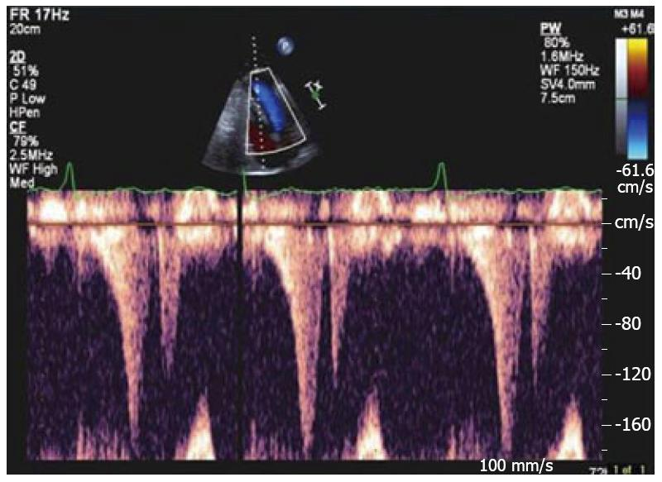
“THE DAGGER”

Slide 36
LVEF
Usually normal or increased
Can have small LV end-diastolic volumes and therefore reduced stroke volumes despite having normal EFs
Overt LV systolic dysfunction, termed the ‘‘dilated or progressive phase of HCM,’’ ‘‘end-stage HCM,’’ or ‘‘burnt-out HCM,’’ is usually defined as an LV EF < 50% and occurs in a minority (2%–5%) of patients
Prognosis is worse in the presence of LV systolic dysfunction

Slide 37
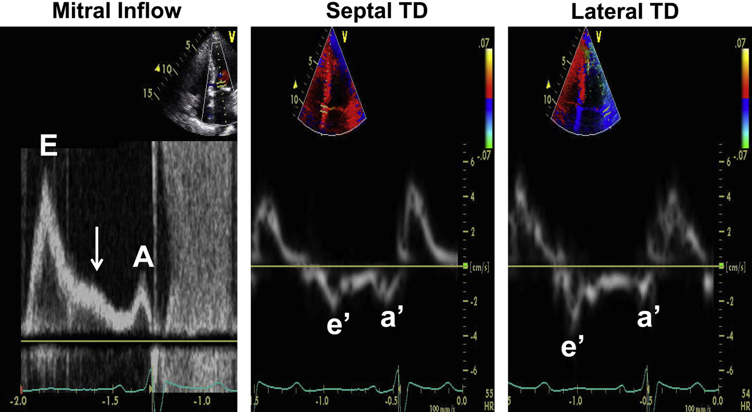
LV DIASTOLIC DYSFUNCTION
Notes:
Assessment of LV diastolic function in a patient with HCM with elevated LA pressure. Mitral inflow shows a restrictive inflow
pattern (E velocity, 140 cm/sec). The arrow points to an L velocity in middiastole, which is observed in the presence of impaired relaxation
and increased filling pressures. Lateral annular and septal annular tissue Doppler (TD) velocities (both e0 and a0) are markedly
reduced consistent with severely impaired LV relaxation. The markedly increased E/e0 ratio is consistent with increased LA pressure >
20 mm Hg. The reduced mitral A velocity with its short deceleration time and the severely reduced a0 velocity are consistent with
increased LV end-diastolic pressure.

Slide 38
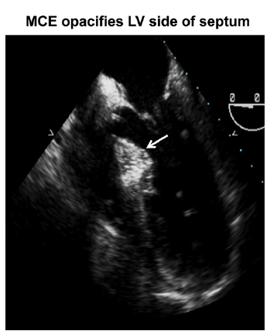
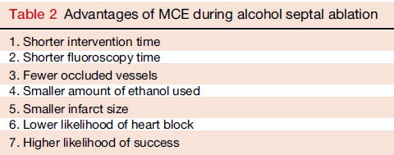
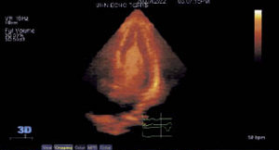
MCE

Slide 39
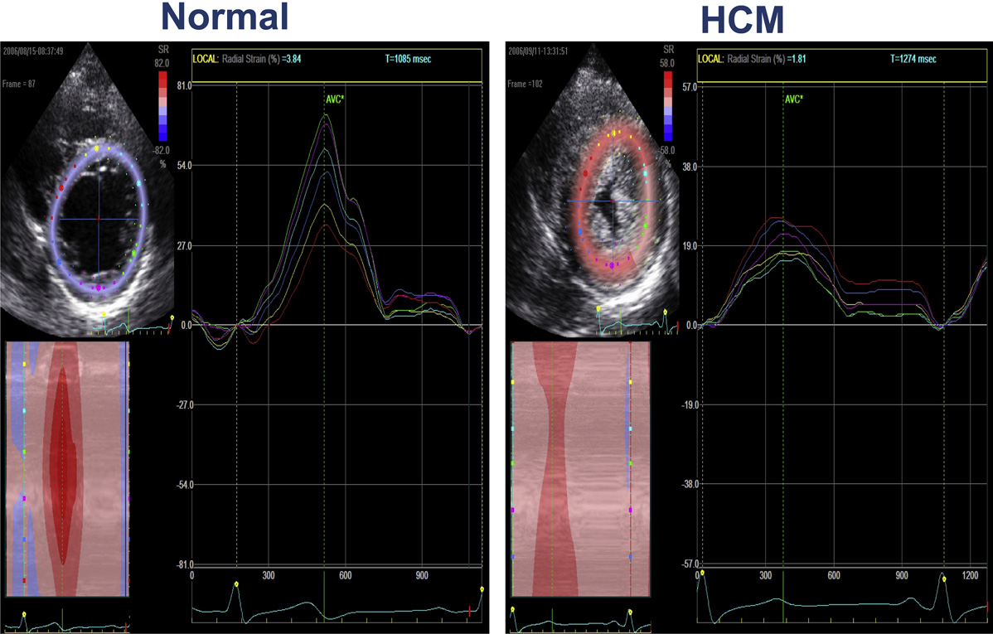
Notes:
Short axis view

Slide 40
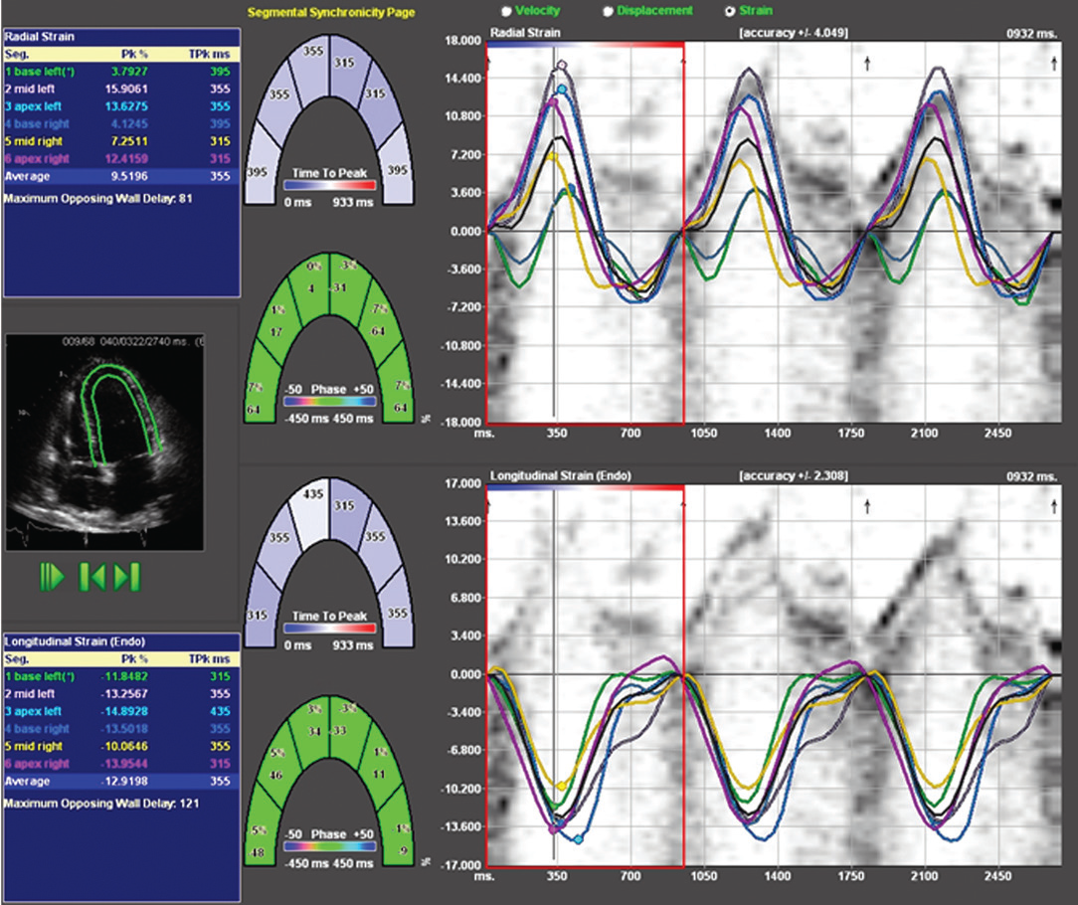
SPECKLE TRACKING IN ECHO

Slide 41
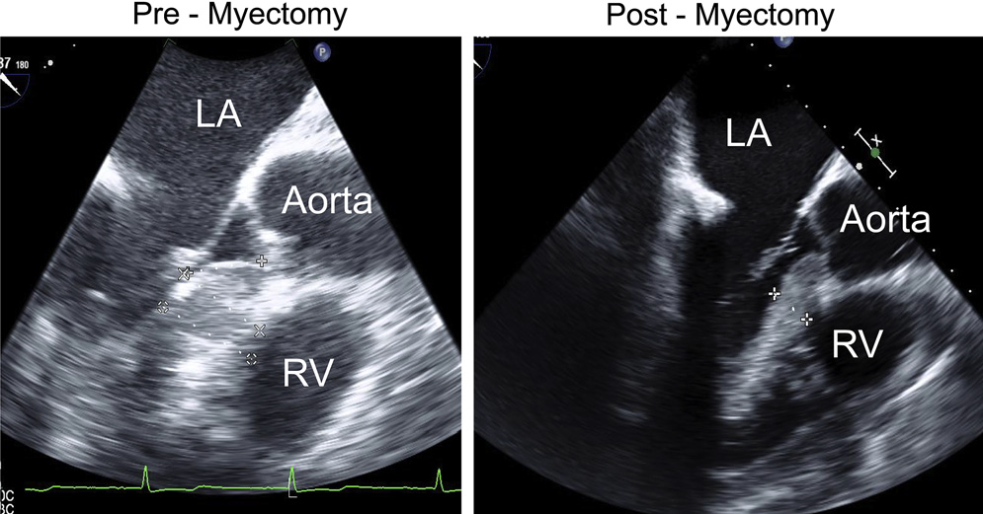
TOE

Slide 42
CARDIAC MRI
Useful when echocardiography is questionable, particularly with apical hypertrophy
Cines loops typically show obstruction and velocity mapping is useful in the assessment of peak velocities
SAM of the mitral valve is clearly seen on cardiac MRI
Improvement in obstruction after septal ablation or myomectomy can be demonstrated, as can the location and size of the associated infarction, which are useful for planning repeat procedures
Cardiac MRI tagging identifies abnormal patterns of strain, shear, and torsion in cases of HCM, demonstrating significant dysfunction in hypertrophic areas of the ventricle

Slide 44
CARDIAC MRI
Gadolinium contrast cardiac MRI - differentiating HCM from other causes of cardiac hypertrophy and other types of cardiomyopathy such as, amyloidosis, athletic heart, and Fabry’s disease
Late gadolinium enhancement occurring in HCM represents myocardial fibrosis
The greater the degree of late gadolinium enhancement, the more likely that the particular HCM patient has 2 or more risk factors for sudden death
More likely the patient has or will develop progression of ventricular dilation toward heart failure, thereby indicating a poorer prognosis
Most patients with HCM have no gadolinium enhancement
Common benign pattern is 2 stripes running along the junction of the right ventricle insertion into the left ventricle

Slide 45
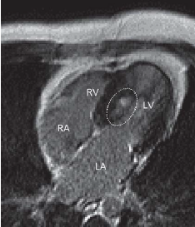
Notes:
DEOMONSATRATING LGE

Slide 46
CARDIAC CATHETERIZATION
Diagnostic cardiac catheterization is useful to determine the degree of LVOT obstruction, cardiac hemodynamics, the diastolic characteristics of the left ventricle, LV anatomy and coronary anatomy
Reserved for situations when invasive modalities of therapy, such as a pacemaker or surgery, are being considered
Therapeutic cardiac catheterization interventions, include transcatheter septal alcohol ablation
The arterial pressure tracing found on cardiac catheterization may demonstrate a "spike and dome" configuration

Slide 47
CARDIAC CATHETERIZATION

Slide 48
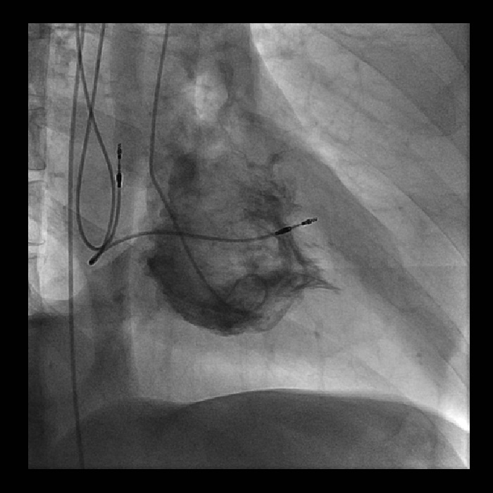
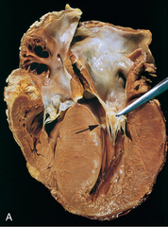
CARDIAC CATHETERIZATION

Slide 49
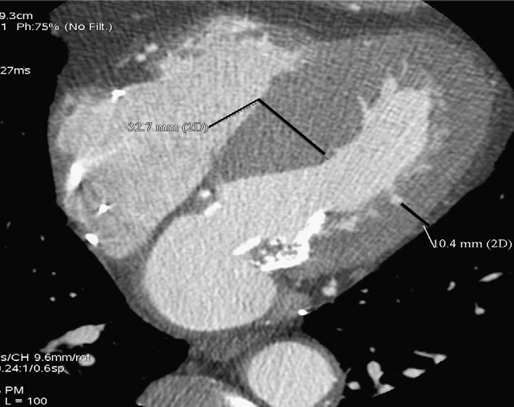
CARDIAC CT !
Notes:
PACEMAKER

Slide 50
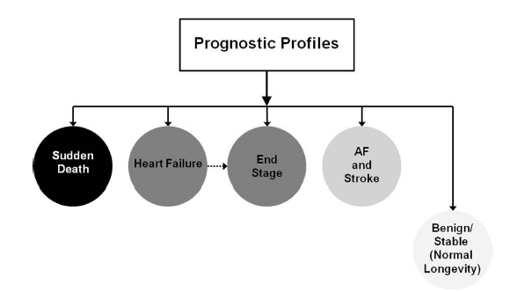
NATURAL HISTORY
Notes:
SUDDEN DEATH
HEART FAILURE-DIASTOLIC-→SYMTPOMS
END SATGE…
AF…20-30%
STABLE MOST…USUAL SYMPTOMS….>.
CAN BE ALTERED BY A NUMBER OF THERPAEUTIC INETERVENTIONS WHICH IS THE SOLE PURPOSE OF ANY MANAGEMENT STRATEGY…
PROGNOSIS OF THE DISEASE…..

Slide 51
BURNT OUT HCM
Burnt out HCM - 3%
Systolic dysfunction EF <50%
Associated with AF
Wall thinning and cavity dilation
Diffuse transmural scarring
Progression to refractory heart failure or sudden death
Mortality 10%/year
Most reliable risk marker - a family history of the end stage

Slide 52
Medical Treatment
Beta blockers
Slowing heart rate
Reducing force of LV contraction
Augmenting ventricular filling and relaxation
Decreasing myocardial oxygen consumption
Long-acting preparations - propranolol, atenolol, metoprolol or nadolol
Blunt LV outflow gradient triggered by physiologic exercise.
Target resting heart rate - 60 beats/min
May require up to 400 mg equivalent of metoprolol

Slide 53
Verapamil (class I)
Add on therapy to beta blockers if high doses of beta blockers are not tolerated
First choice when beta blockers are contraindicated
Maximal doses of 280 mg/day
AVOID in NYHA class IV dyspnoea and hypotension
When used as add-on therapy→to look for high grade AV block
Diltiazem – when verapamil cannot be used

Slide 54
Disopyramide
Negative inotropic effect decreases the gradient and improve symptoms.
Concomitant beta blockade may be important to prevent rapid atrioventricular node conduction
Between 300 and 600 mg/d
The corrected QT interval must be monitored
Anticholinergic side effects in older patients

Slide 56
DRUGS THAN CAN HARM(CLASS III)
Nifedipine, Nitrates, Diuretics -potent vasodilator and hence avoided
Digoxin, dobutamine, noradrenaline, dopamine-positive inotropes
MANAGEMENT OF ACUTE HYPOTENSION IN HOCM
i.v fluids
phenylephrine
Iv beta blockers
MANAGEMENT OF HCM WITH LV SYSTOLIC DYSFUNCTION
ACEI/ARBS, diuretics-standard HF treatment
Discontinue verapamil, diltiazem, disopyramide (class iii)
Notes:
THEN HOW DO WE MANAGE HYPOTENSION IN HOCM….

Slide 57
MANAGEMENT OF AF
A/c AF+ hemodynamically unstable= DC
A/C AF + angina /pulmonary edema = BB/A–iv
Hemodynamically stable= 3W OAC >>DC
Rate control with oral BB/ CCB
rhythm control with amiodarone
Flecainide and propafenone, should be avoided as they may prolong QRS duration and the QT intervaL
AV nodal ablation F/B DDD/VVIR/CRT IN drug refractory
Radiofrequency ablation (II A)

Slide 58
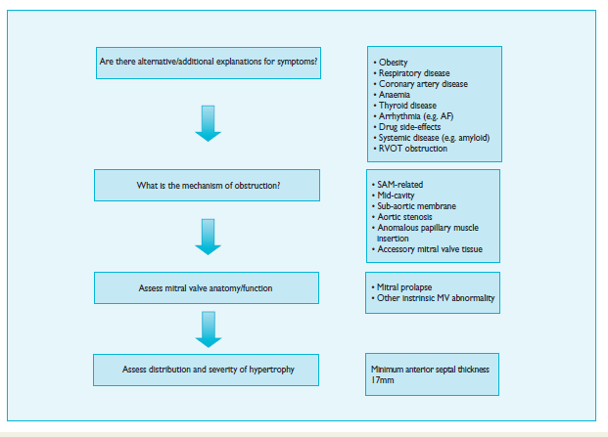
Notes:
LVOTO MANAGEMENT

Slide 59
SEPTAL MYECTOMY (Morrow procedure)
Drug-refractory heart failure symptoms
NYHA Classes III and IV or exersional syncope
LV outflow obstruction
gradient ≥ 50 mm Hg
Better surgical candidates
Younger age
Greater septal thickness (≥30 mm)
Concomitant cardiac diseases –valvular/CAD
Complications
Perioperative Mortality (1-5%)
VSD - 3%
CHB and PPI (5%)
CVA 1-2%
LBBB-40%

Slide 60
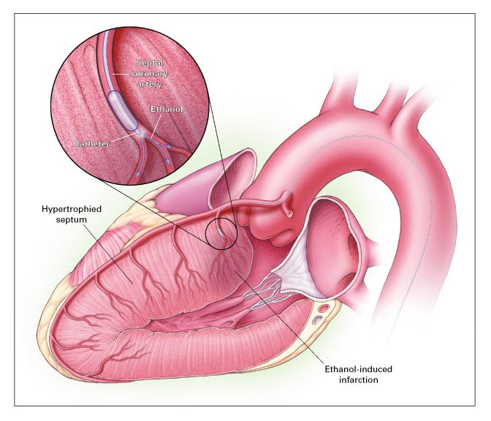
Alcohol-Induced Septal Ablation
Braunwald, E. N Engl J Med 2002;347:1306-1307

Slide 61
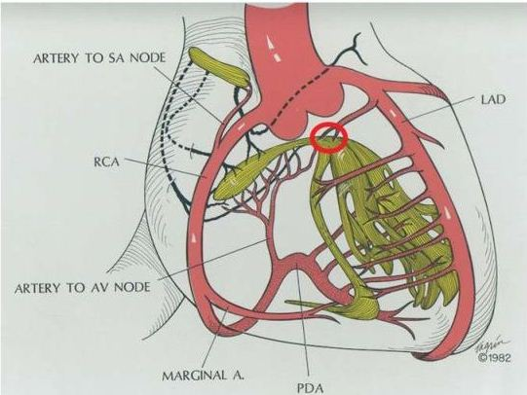
Notes:
The target septal branch may occasionally
originate from the left main coronary artery, an intermediate
or diagonal branch or the posterior descending coronary
artery.

Slide 62
TRIPHASIC RESPONSE

Slide 63
OTHER THAN ALCOHOL!!!
Polyvinyl alcohol foam particles,
Microspheres,
Absorbable gelatin sponges,
Septal coils
Gross CM, Schulz-Menger J, Kramer J, Siegel I, Pilz B, Waigand J, Friedrich MG, Uhlich F, Dietz R. Percutaneous transluminal septal artery ablation using polyvinyl alcohol foam particles for septal hypertrophy in patients with hypertrophic obstructive cardiomyopathy: acute and 3-year outcomes. J Endovasc Ther2004;11:705–711.
Llamas-Esperon GA, Sandoval-Navarrete S. Percutaneous septal ablation with absorbable gelatin sponge in hypertrophic obstructive cardiomyopathy. Catheter Cardiovasc Interv 2007;69:231–235.
Lafont A, Durand E, Brasselet C, Mousseaux E, Hagege A, Desnos M. Percutaneous transluminal septal coil embolisation as an alternative to alcohol septal ablation for hypertrophic obstructive cardiomyopathy. Heart2005;91:92

Slide 64
Conclusion SA does seem to show promise in treatment of HOCM owing to similar mortality rates as well as functional status compared with SM; however, the caveat is increased conduction abnormalities and a higher post-intervention LVOTG. The choice of treatment strategy should be made after a thorough discussion of the procedures with the individual patient. (J Am Coll Cardiol 2010;55:823–34)

Slide 65
DUAL-CHAMBER PACING
Proposed benefit:
Pacing the RV apex will decrease the outflow tract gradient by decreasing projection of basal septum into LVOT
Several RCTs have found that the improvement in subjective measures provided by dual-chamber pacing is likely a placebo effect
Other treatment
EP
CRT
CARDIAC TRANSPLANTATION/VAD
Notes:
Decreased projection of basal septum into the LVOT

Slide 66
EFFICACY OF THERAPEUTIC STRATEGIES
Nishimura et al. NEJM. 2004. 350(13):1323.

Slide 67
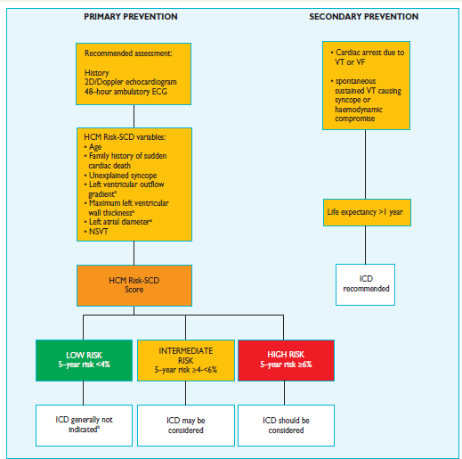
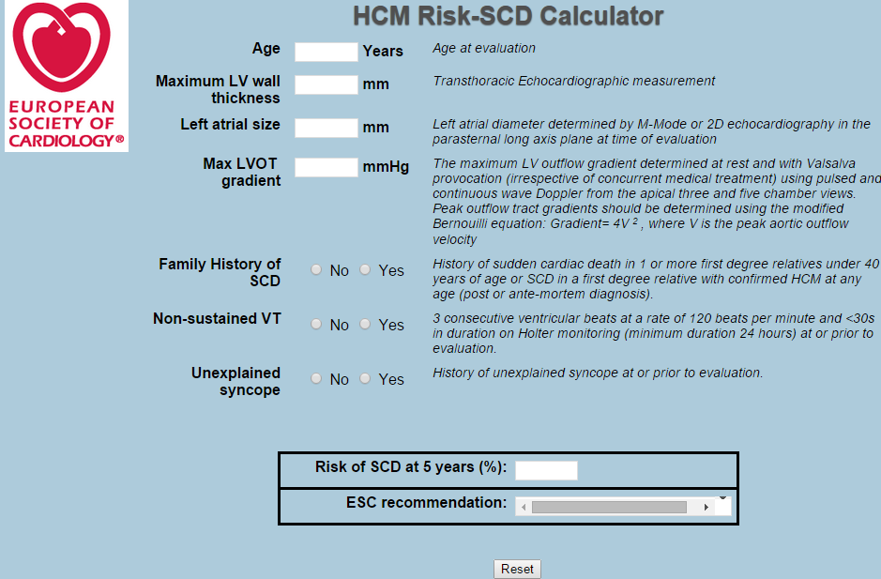

Slide 68
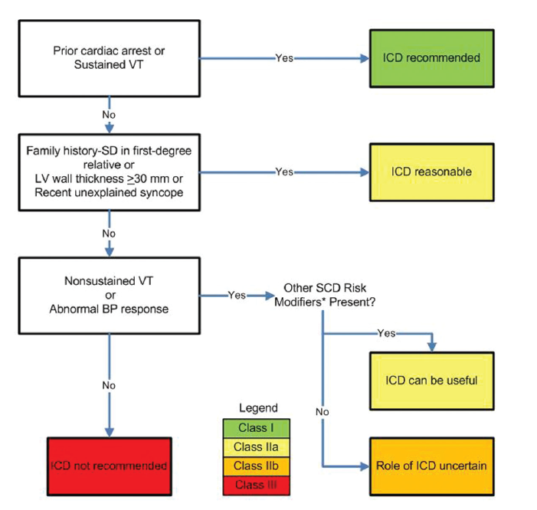

Slide 69
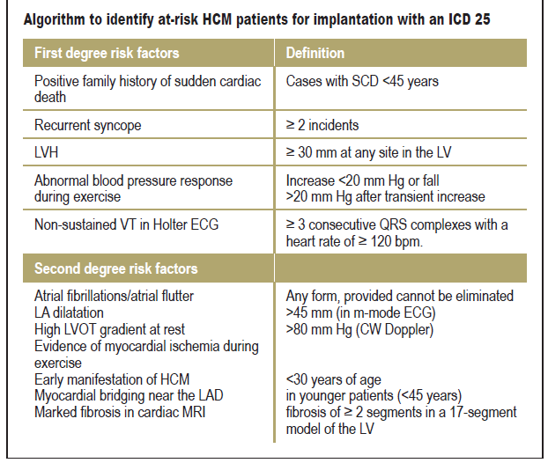

Slide 71
PREGNANCY/DELIVERY
High risk for- LVOT gradient > 50 mmhg
Class III for those with class III/IV systolic dysfunction
No added risk for patients with controlled symptoms (II A)
Continue drugs in prgnancy (class I)-watch or fetal bradycardia and growth abnormalities in fetus
Guard against post delivery volume loss

Slide 72
PHYSICAL ACTIVITIES
Low intensity aerobic exercises
Avoid dehydration
Avoid heavy meals
Risk of syncope in high intensity sports
Unpredictability of SCD→an other reason to avoid high intensity sports
Notes:
Examples like golf, bowling,brisk walking… Well defined in acc 2011 guifddlines on what sports are permitted and a=what not…

Slide 73
What to expect in future!!!
ASA OVERTAKING SURGERY
ALTERNATIVES TO ALCOHOL
INCLUSION OF CARDIAC MRI IN DIAGNOSIS AND RISK STRATIFICATION
PRECLINICAL DIAGNOSIS WITH ECHO

Slide 74
Thank You

